Slide 1

Impact of Remote Work on Mental Health
Jeremy Bentley
Michael Hennessy
Hemangi Shah
Priya Balasubramanian

Slide 2

TABLE OF CONTENTS 1. Introduction project overview 2. Coding Approach 3.Data Analysis Data cleaning and preprocessing 4. Conclusion

Slide 3

OVERVIEW
The increase in remote work is influencing the mental well-being of employees, so it is essential to understand how remote work affects them.​
Using this dataset, we analyze the effects of working remotely on stress levels, work-life balance, and mental health conditions across different industries and regions, across various countries and regions of the world.​
As a result of the collection of 5,000 records from employees globally, this dataset is able to offer valuable insights into key areas like work location (remote, hybrid, onsite), stress levels, mental health resources, and job satisfaction.​

Slide 4

DATASET
Size of Dataset : 598.57 kB
Content: This dataset examines the impact of remote work on mental health, gathering response from individuals across various demographics. It includes key metrics such as job satisfaction, anxiety levels and work-life balance.ls, and work-life balance
Number of records: 5000 rows
Number of columns: 20 columns
Key Features
Diverse Respondents: Data from different age groups and professions.
Mental Health Insights: Explore the effects of remote work conditions.
Source
https://www.kaggle.com/datasets/waqi786/remote-work-and-mental-health

Slide 5





ETL PROCESS

Slide 6
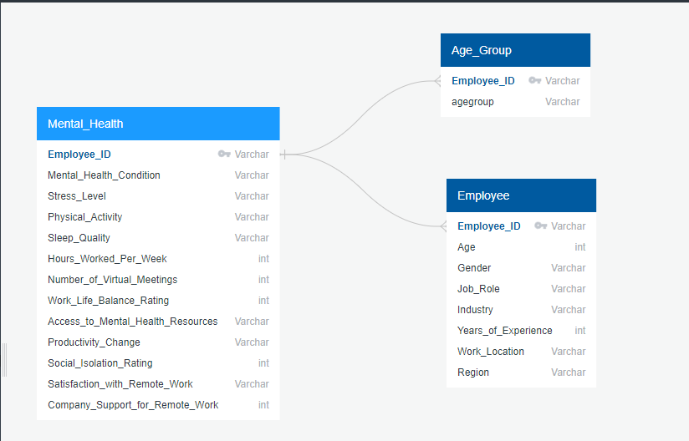
ERD
The primary key Employee_ID links the different tables to the database together

Slide 7
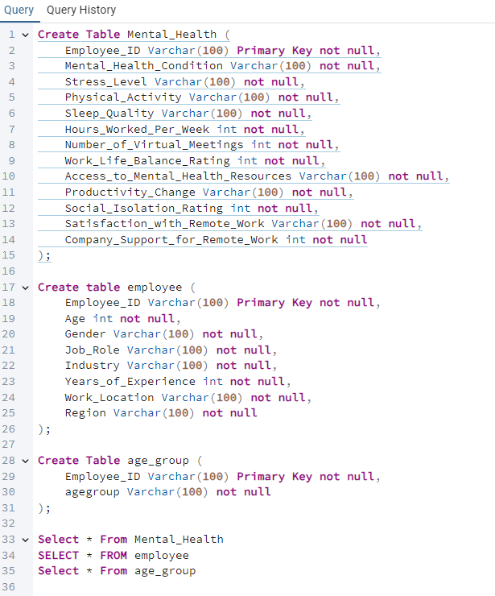
Database
Utilized three CSV files for our database in PostgreSQL
Mental_Health
Age_Group
Employee

Slide 8

DATA - ANALYSIS

Slide 9
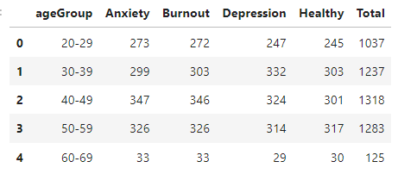
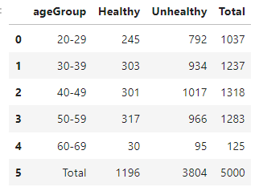
Impact of Mental Health by Age
Initially analyzed the dataset by grouping the age of each employee into bins. Within each age group, there wasn’t a specific age rage that had a significantly higher total number of employees report Anxiety, Depression, or Burnout. Overall, the totals seemed pretty even within each age group.
To make the view a bit more clear, I regrouped Anxiety, Burnout, and Depression into a single category named "Unhealthy".
Employees ranging from 40-49 seemed to have the highest level of unhealthy mental states, but were also the largest group tested.
Reviewing the totals, it is interesting to see that the majority of employees reported Anxiety, Burnout or Depression regardless of age.

Slide 10
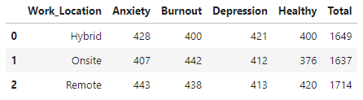
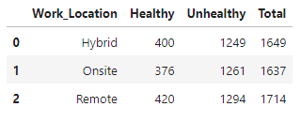
Impact of Work Location on Mental Health
Then used Pandas to further analyze the dataset and determine the overall effect of the work location on each employees mental health.
When looking at each option, there wasn't a significant difference between Hybrid, Onsite, or Remote.
Overall, the total number of employees that reported unhealthy mental health conditions surpassed healthy. The work location didn't seem to have a significant effect on each total, but was still interesting to see the majority of employees report an unhealthy mental state.

Slide 11
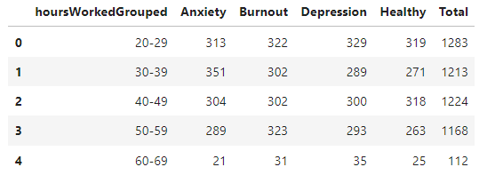
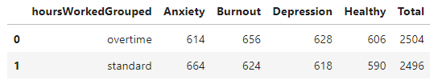
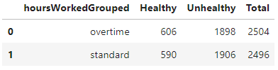
Impact of Hours Worked on Mental Health
Initially, I reviewed the mental health condition reported by each employee based on their overall hours worked. I grouped the hours worked into bins, and reviewed totals of each specific mental health condition within each bin. There wasn't a specific hourly range that seemed to surpass another by a significant amount, so I regrouped the hours into "overtime" (40+), and "standard".
Within the two groups, it was interesting to see that employees working standard hours surpassed overtime employees that reported Anxiety. Still, the two groups didn't seem to have a large difference.
I regrouped Anxiety, Burnout, and Depression as "Unhealthy" and standard employees did surpass overtime employees that reported unhealthy conditions.

Slide 12
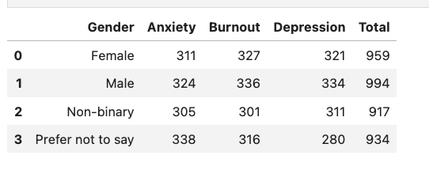
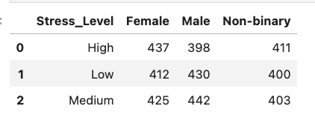
Mental-Health and Stress Outcome By Gender
Mental-Health Impact
Mental health and stress levels can vary significantly by gender.
This dataset dives into how working remotely affects stress levels, work-life balance, and individual’s mental health conditions.
It's interesting to consider the different ways stress and mental health manifest in different genders. Research shows that male may experience higher rates of certain mental health conditions, like depression and anxiety, despite they handle stress better.
On the other hand Females are reported with higher stress level however experience lower rates of certain mental health conditions than males.
Stress Impact

Slide 13
Certain roles may be more conducive to remote work than others.
For example, IT and HR roles may adapt better to remote work compared to roles that requires hands-on collaboration.
Longer hours leads to increased stress levels.
Remote workers may experience feelings of isolation due to lack of in-person interaction. This could be particularly relevant for younger employees or those in industries that rely on teamwork.
Older employees may far better in remote settings due to established coping strategies.
By demographic data like age, gender, certain groups are more affected by remote work.
Interpretation​

Slide 14
Implications​
These insights suggest that organizations should pay special attention to mental health of remote workers.
Providing resources such as mental health support, opportunity for social interaction could help the negative impacts of remote work on mental health.
Implement programs to reduce social isolation among remote employees.
Encourage physical activity and work-life balance to improve overall mental health.
Organizations should consider implementing strategies to support the mental well-being of their remote employees.

Slide 15
Thank You

